Slide 1

Library Management System with JavaFX
Building a Modern, User-Friendly Interface for Efficient Library Operations

Slide 2





Why JavaFX for Library Management?
Cross-Platform Power
Rich UI controls with CSS styling that works seamlessly across Windows, Mac, and Linux
Visual Design Tools
Scene Builder enables drag-and-drop UI design, dramatically accelerating development
Smooth Performance
Hardware-accelerated graphics ensure fluid, responsive user interactions
Easy Integration
Connects effortlessly with Java backend and MySQL databases for robust data management

Slide 3
Core Features Overview
1
2
Book Management
Member Management
Comprehensive tools to add, update, delete, and search books by title, author, or genre with advanced filtering capabilities
Register new library members, edit existing profiles, and efficiently remove inactive accounts to maintain data integrity
3
4
Transaction Handling
Dashboard Analytics
Track borrowing and returns with automated overdue detection, fine calculation, and complete transaction history
Real-time statistics displaying active books, registered members, current transactions, and key performance metrics

Slide 4

User Roles & Interaction Diagram
Member
Search catalog and view borrowed books
Librarian
Manage lending/returns and view reports
Admin
Full access: books, members, transactions, reports
Admin
Librarian
Member
Complete system control with full access to manage books, members, transactions, and generate comprehensive reports
Manage lending/returns and view reports
Searches the catalog, views personal borrowed books, checks due dates, and manages their library profile
Handles day-to-day operations including book lending, returns, member assistance, and accessing activity reports

Slide 5
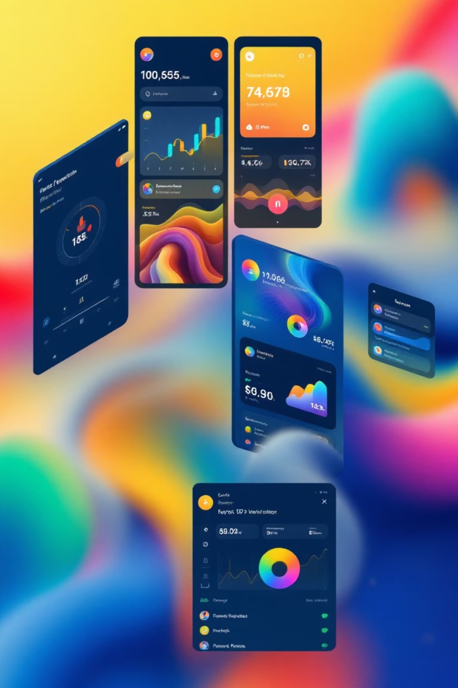
JavaFX Interface Design Highlights
Clean, Modern Aesthetics
Intuitive UI styled with custom CSS for professional appearance and effortless navigation across all screens
Scene Builder Integration
Visual design of all screens—Login, Dashboard, Book Management, and Member Management—using drag-and-drop tools
Dynamic Data Tables
TableViews display books and members with built-in sorting, filtering, and pagination for handling large datasets efficiently
Interactive Controls
Responsive buttons, forms, and dialogs enable seamless CRUD operations with real-time validation and user feedback

Slide 6





Demonstration Flow
Login Screen
Secure authentication system validates credentials and grants role-based access to appropriate system features
Dashboard Overview
Central hub displaying quick statistics, recent activity, pending returns, overdue notifications, and system alerts
Book Management
Add new titles with ISBN and details, update book information, mark lost items, and remove obsolete entries from catalog
Member Management
Register new members with contact details, edit existing profiles, suspend accounts, and remove inactive users from system
Issue & Return Books
Process lending transactions, record returns with condition notes, automatically calculate late fines, and update availability status

Slide 7

Summary & Next Steps
Powerful Platform
JavaFX provides a robust foundation for building rich, maintainable library management systems with professional-grade interfaces
Expandable Architecture
Modular design supports easy feature additions like email notifications, advanced reporting, and mobile integration
Database Ready
Seamlessly integrates with MySQL or PostgreSQL for persistent storage, ensuring data reliability and scalability
Ready to explore? Demo code available on GitHub at nipunnishamaheeka/library-management-system
"Let's build a seamless library experience together and transform how communities access knowledge!"

